Slide 1
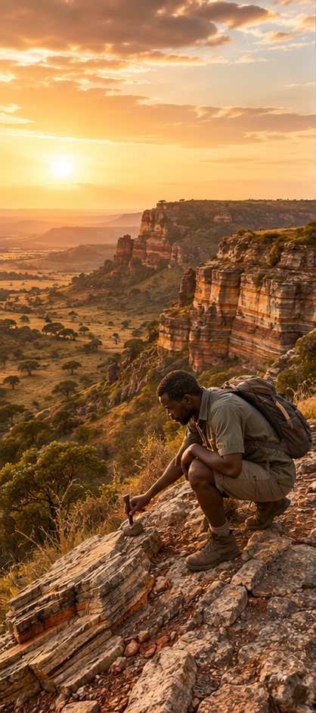
Field Notes: Africa Beneath Your Feet
The Hidden Story of a Landscape — Geology Study Companion (Module 2)
ECOTRAINING US HIGH SCHOOL PROGRAMME · AGES 15–17
One question drives everything: How can the ground beneath your feet help a field guide read the landscape above it?

Slide 2

Your Mission
Two Routes. One Choice.
How to Use This Guide
At sunrise, a field guide must choose between two routes. Guests hope to see elephants.
1
Watch
All three video parts
2
Run
The Landscape Detective mission
3
Take
The Knowledge Check — everything on the quiz is in these pages
Route A
Route B
Rounded granite country · pale sandy soils · marula trees
Darker basalt country · fine soils · different plants

Slide 3
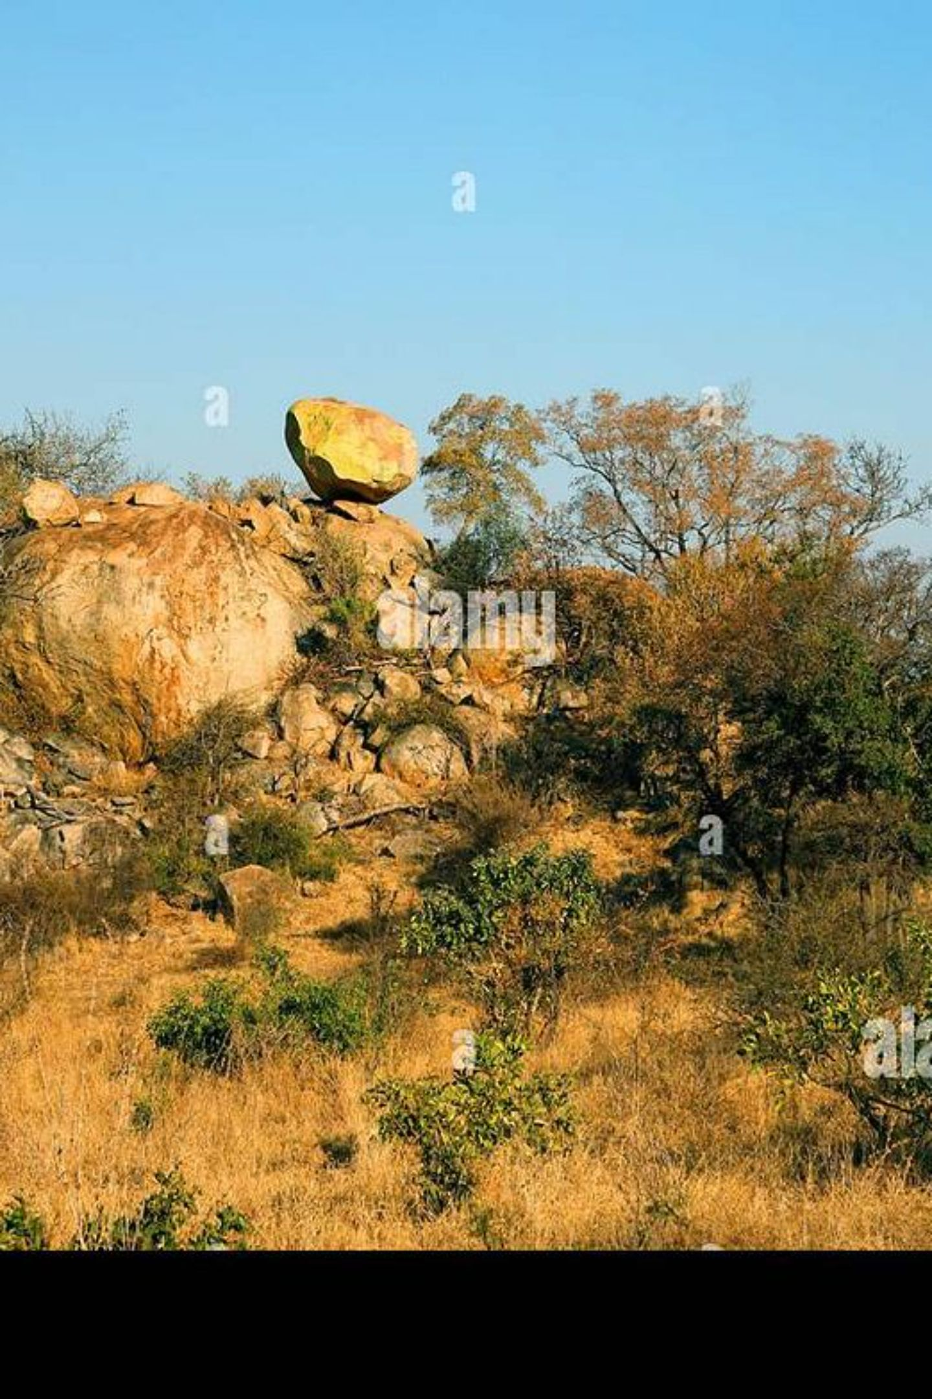
PART 1
Read the Ground
Earth's hidden engine: the words, the layers and the moving plates that built Africa.

Slide 4

Four Words That Unlock a Landscape
Geology
Topography
The study of Earth — its materials, structure, history and the processes that keep changing it. The story below.
The shape of a place — hills, valleys, plains, rivers, slopes. The shape you can see above.
Geomorphology
Landform
The study of how that shape formed. It connects geology to topography by asking: which processes made this?
One recognisable feature — a mountain, plateau, valley or canyon. The building block of landscape.
The shortcut: Geology is the material and story BELOW. Topography is the shape ABOVE. Geomorphology connects the two.

Slide 5
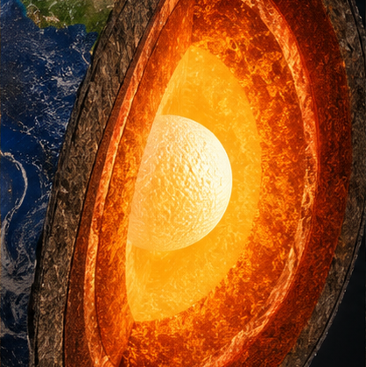
Inside Earth
Crust
Mantle
Thin, brittle outer skin — ~5 km under oceans, ~30 km under continents.
Nearly 3,000 km of hot, mostly solid rock — not liquid lava. Deforms slowly over geologic time.
Outer Core
Inner Core
Liquid iron and nickel. Its movement generates Earth's magnetic field.
Solid metal — immense pressure keeps it solid despite extreme heat.
Scientists mapped all of this indirectly — earthquake waves act like a scan of the planet.

Slide 6
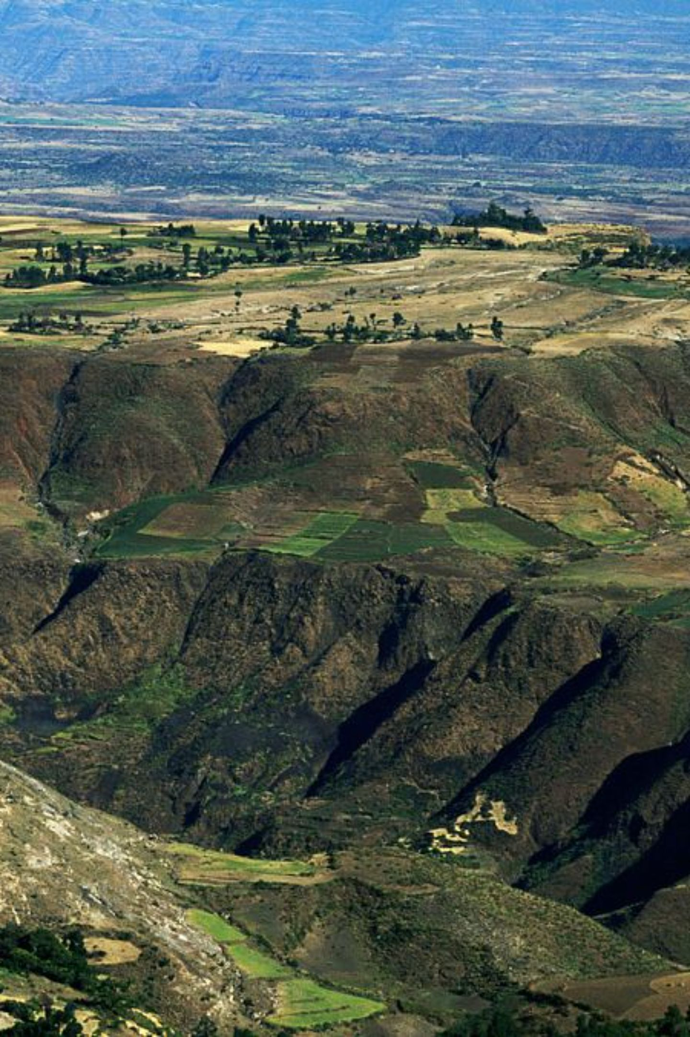




The Moving Plates
The crust plus the rigid uppermost mantle form the lithosphere — broken into enormous plates that move a few centimetres a year, about the speed your fingernails grow.
Pull Apart
Rift valleys open · new crust forms · East Africa is stretching right now
Push Together
Mountains rise · or one plate sinks beneath another
Slide Past
Rocks lock · stress builds · releases as earthquakes
Mountains and valleys are not scenery — they are evidence.

Slide 7
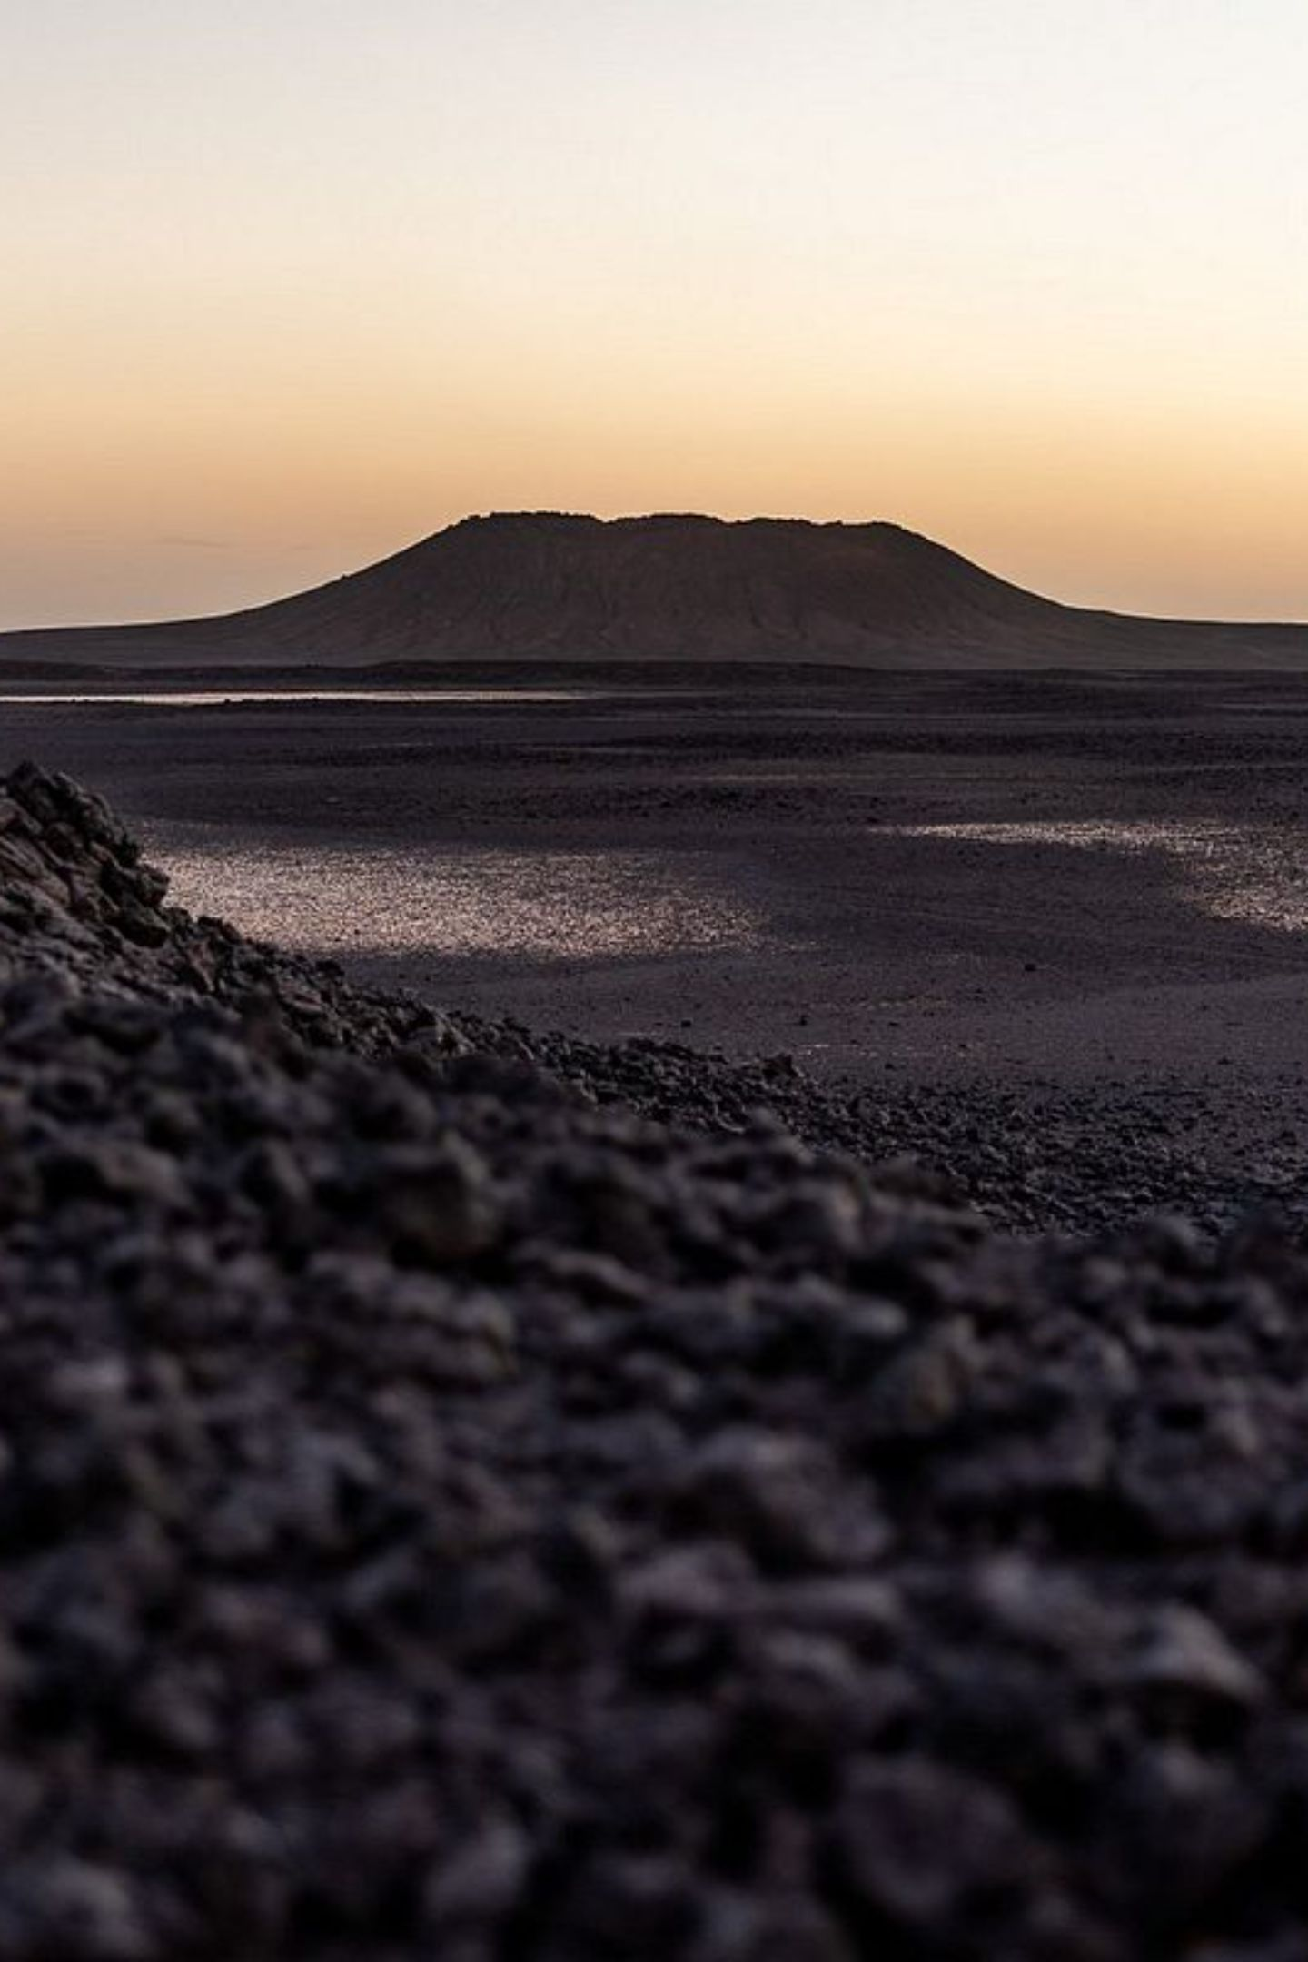
PART 2
The Rock Cast
How one planet builds three completely different families of rock.

Slide 8
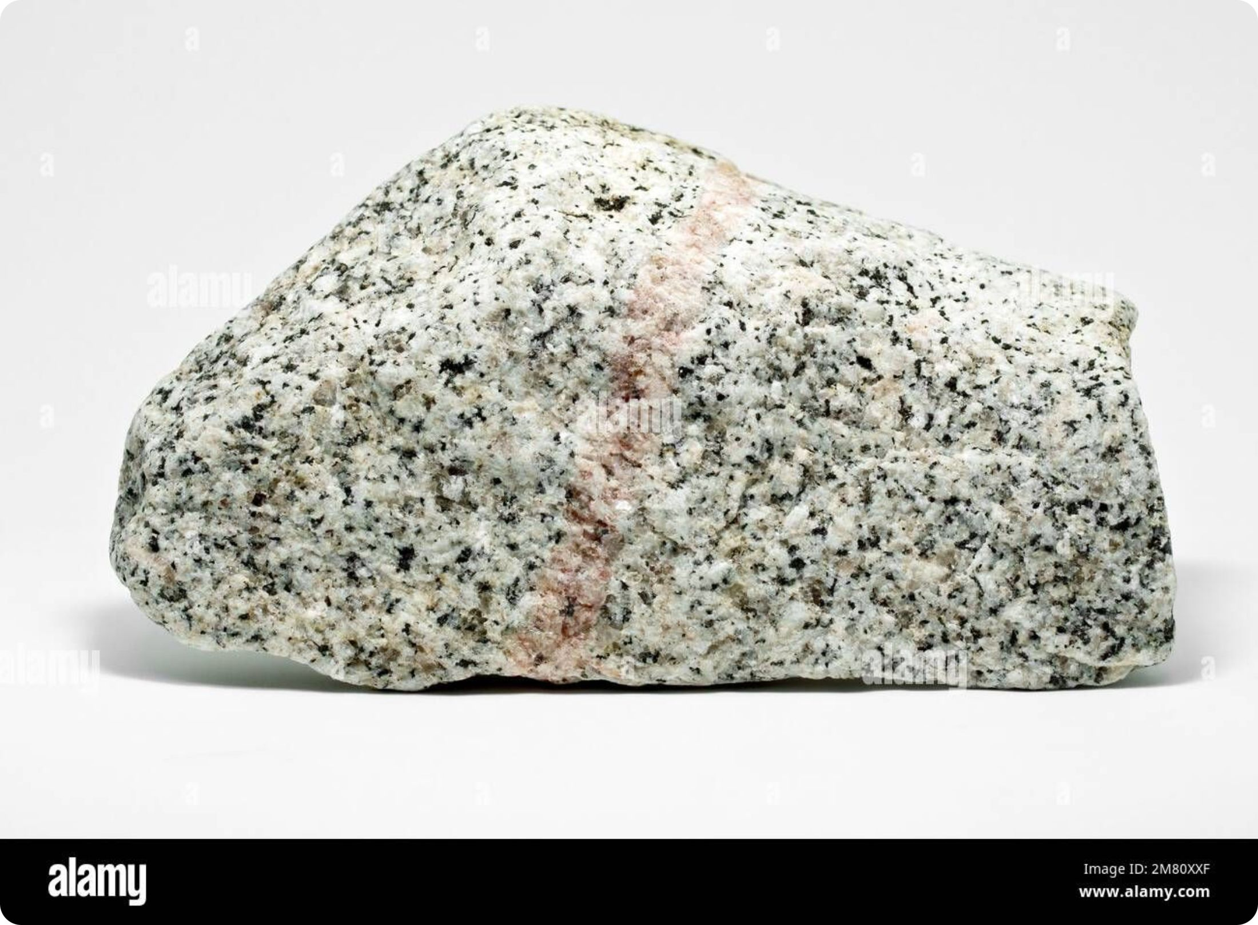
Minerals vs. Rocks
[Editor note: replace this card's image with the supplied "NLM-minerals-vs-rocks-baked-cake.png" visual.]
Mineral
Rock
A naturally occurring, non-living solid with an organised internal structure. Think of minerals as the ingredients.
A naturally formed mixture of one or more minerals — the finished bake. Granite's speckles are its ingredient minerals: quartz, feldspar and mica, visible to the naked eye.

Slide 9
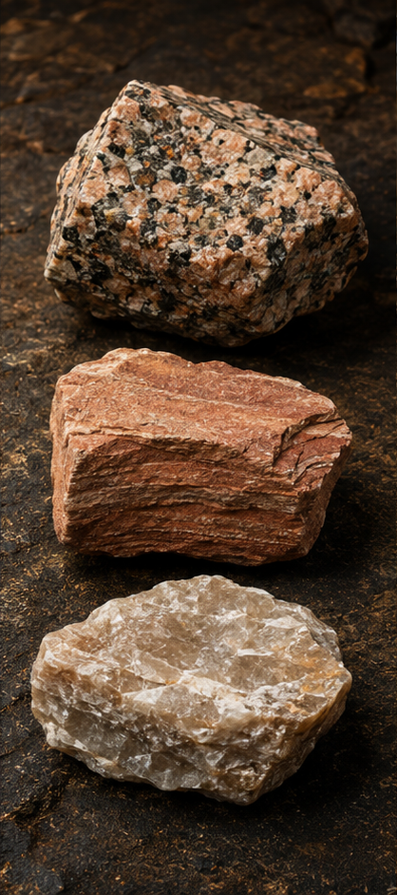
The Three Rock Families
Origin is the key idea that separates the families — and each origin leaves visible clues.
Igneous
Sedimentary
Metamorphic
Formed when melted rock cools and solidifies. The fire family — born from magma or lava.
Formed when deposited material is compacted and cemented. Built from fragments of other rocks.
Existing rock changed by heat and pressure while remaining solid — transformed, never melted.

Slide 10
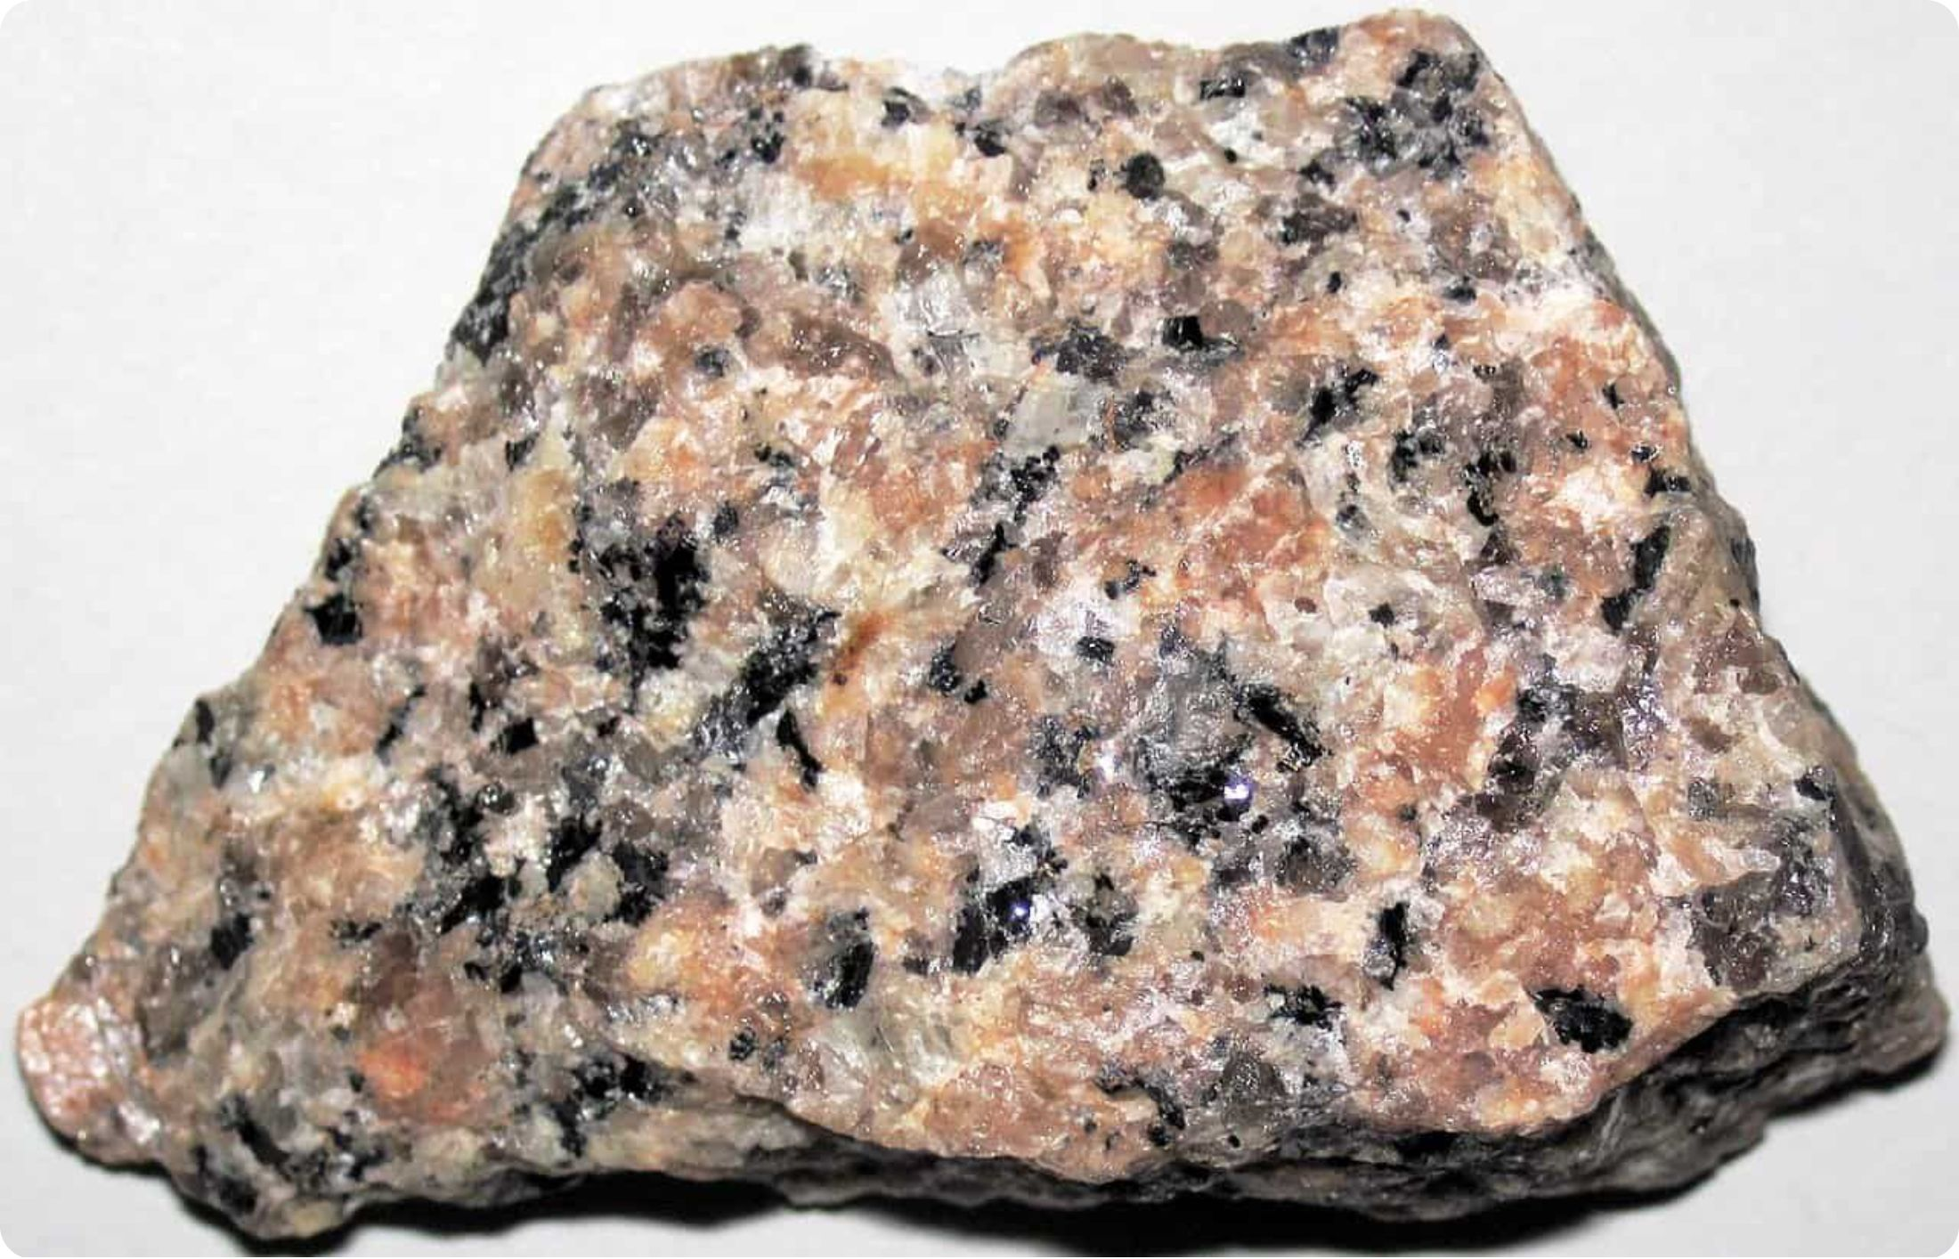
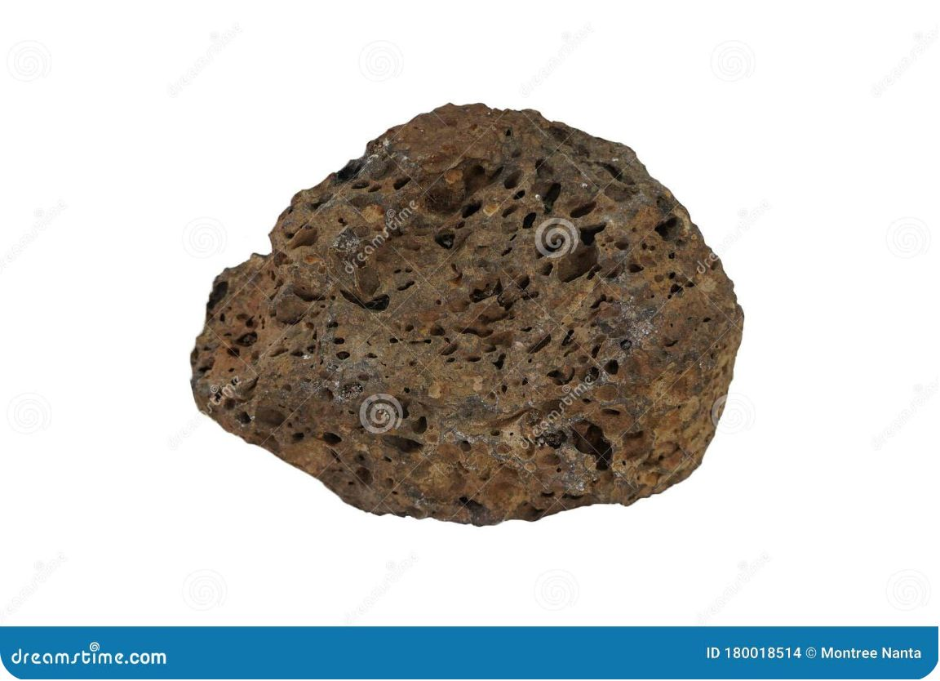
The Crystal-Size Clue: Granite vs. Basalt
Granite — Slow Cooling
Basalt — Fast Cooling
Intrusive · cooled deep underground · crystals had time to grow large — you can see them with the naked eye.
Extrusive · cooled quickly at the surface · crystals stayed too small to see — dark and fine-grained.
Read the crystals and you read the cooling story.

Slide 11

Sandstone and Quartzite: One Rock, Two Chapters
Sandstone
Sand is deposited in layers, compacted by burial, then cemented by natural minerals. A sedimentary rock.
Quartzite
Add heat and pressure — without melting — and sandstone transforms. Grains fuse into a harder, pale metamorphic rock.
Deposition
Compaction
Quartzite
Metamorphic rock never melts. Melting would create magma and start an igneous story instead.

Slide 12

The Rock Cycle Is a Network, Not a Loop
Magma → Igneous
Igneous → Sediment
Sedimentary → Metamorphic → Magma
Sediment → Sedimentary
Every transformation path is legal — cooling, weathering, erosion, deposition, compaction, heat, pressure, melting. A basalt pebble can weather into grains, travel downstream, settle and become sandstone — which can become quartzite, or melt into magma.
[Editor note: replace this card's image with the supplied "NLM-rock-cycle-network.png" visual.]

Slide 13
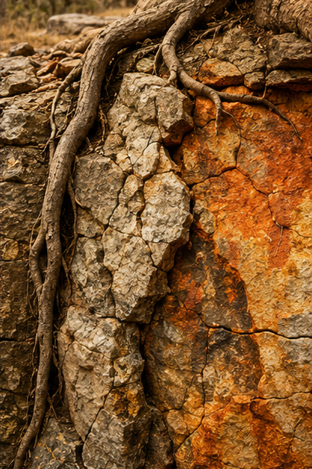
PART 3
The Sculptors
Air, water, temperature and life carve rock into the landscape a guide actually sees.

Slide 14
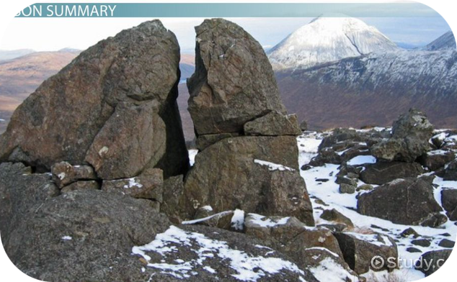

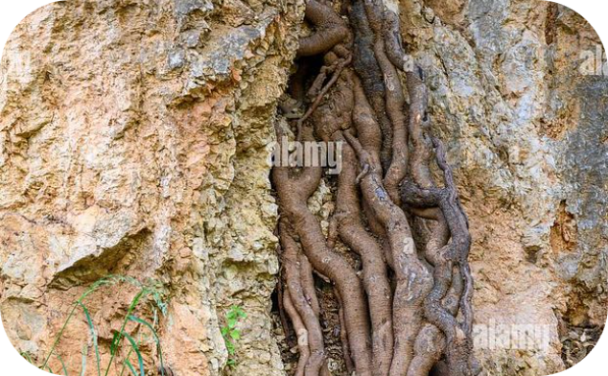
Three Sculptors at Work
Physical Weathering
Chemical Weathering
Biological Weathering
Temperature swings and ice wedging crack rock apart — force, not chemistry. The rock breaks but its minerals stay unchanged.
Oxygen and water react with minerals. That orange-brown "rust" stain on a rock face is chemical weathering made visible.
Living things do the work — a root thickening in a crack is biological weathering with a powerful physical effect.

Slide 15
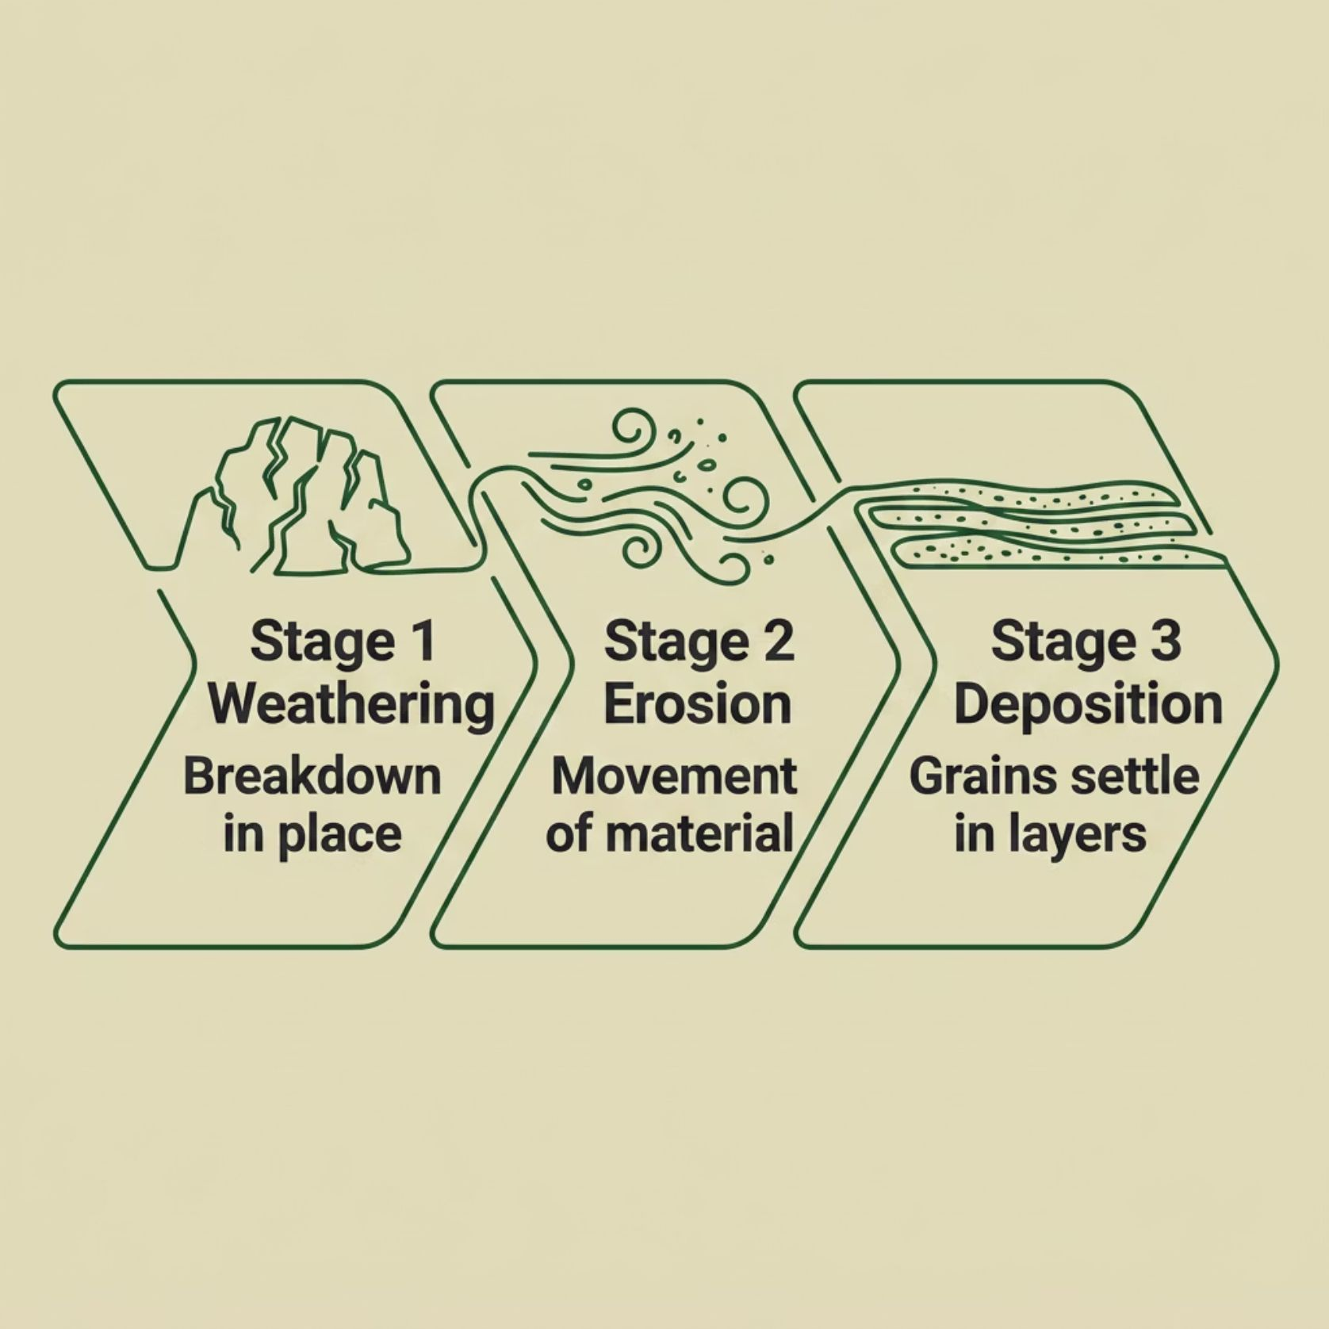
Weathering ≠ Erosion
Weathering
Breaks down or alters rock in place. No movement — this is the distinction guides never blur.
Erosion
Moves the loose material — by water, wind, ice or gravity. If it has moved, it is no longer just weathering.
Deposition
Where the journey ends: transported grains settle in layers.

Slide 16
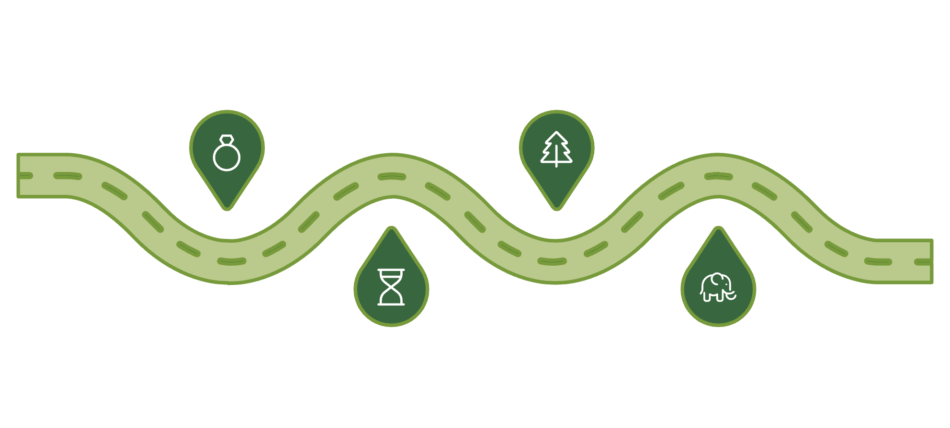

Solve the Route
Granite Country
Marula Trees
Bedrock creating coarse soils
Fruitful trees in the Lowveld
Sandy Soils
Elephant Signs
Well‑drained soils from granite
Animals drawn to seasonal fruit
Say it like a guide: geology improves the odds — it never guarantees the animal. A real guide checks fresh tracks, water and conditions before deciding. Evidence, not certainty.

Slide 17
Three Anchors to Remember
The Engine
The Families
The Sculptors
Earth's moving plates build the large framework. Landforms are evidence of deep processes.
Igneous, sedimentary and metamorphic origins leave visible clues in crystals, grains and layers.
Weathering breaks and changes rock in place; erosion moves it — together they carve landscape, soil and habitat.
[Editor note: replace this card's image with the supplied "NLM-three-memory-anchors.png" visual.]

Slide 18
Field Guide Glossary
Geology
Topography
Mantle
Lithosphere
Study of Earth's materials, structure, history and processes.
The shape and features of a place.
Thick layer of hot, mostly solid rock that deforms slowly.
Rigid crust + uppermost mantle, broken into plates.
Geomorphology
Landform
Tectonic Plate
Mineral
The study of landforms and how they formed.
A recognisable surface feature.
A huge, rigid, slowly moving piece of lithosphere.
Natural non-living solid with an organised internal structure.
Crust
Rock
Earth's thin, brittle outer layer.
Natural solid mixture of minerals.

Slide 19
Glossary Continued
Magma / Lava
Igneous
Rock Cycle
Weathering
Melted rock below the surface (magma) or at the surface (lava).
Rock from cooled melted rock. Intrusive: slow cooling underground (large crystals). Extrusive: fast cooling at the surface (small crystals).
The network of processes transforming rock between families.
Breakdown or alteration of rock in place.
Erosion
Deposition
Movement of weathered material by water, wind, ice or gravity.
Settling of transported sediment in layers.
Sedimentary
Metamorphic
Deposited material compacted and cemented into rock.
Existing rock changed by heat and pressure while staying solid.
Evidence Chain
A linked explanation where each observation supports the next, without claiming certainty.

Slide 20

Your Field Mission
Find one rock where you live. Photograph it in place. Record five observations before trying to name it.
1
2
3
Grain
Layer
Colour
Separate grains or crystals? Coarse or fine?
Bands, layers, holes or a glassy surface?
List every colour — never name a rock by colour alone.
4
5
Change
Place
Cracks, rounded edges, rust colours, roots, loose sediment nearby?
Slope, water, soil, wall, or loose on the ground?
Saying "I cannot identify it yet" is good science. Safety: observe from safe, permitted places; leave rocks where you find them in parks and reserves.

Slide 21
Next Trail: Weather & Climate
You can now read the ground. Next month, look up — how the atmosphere changes what a guide sees, hears and plans for, from Lowveld storms to the winds that shape a safari day.
Before Then
Complete the Knowledge Check — 10 questions, unlimited retries, your highest score counts.
One Day
Read the real thing with us in the South African bush. EcoTraining — Guides and Guardians.
www.ecotraining.co.za

